Slide 1
SCAN CONVERSION
Book: Computer graphics(Schaum’s outline-2nd edition), Zhigang xiangm roy A plastock

Slide 2
Scan Conversion
Process of representing graphics objects as a set of pixels.
Graphics objects are continuous; the pixels used a re discrete.
Convert each primitive from its geometric definition into a set of pixel is known as scan conversion or rasterization.

Slide 3
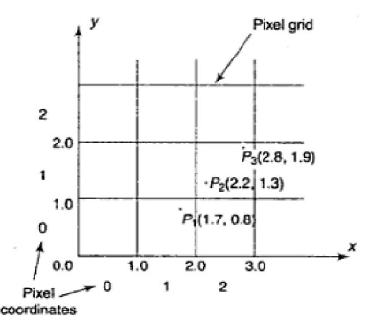
Scan Converting a Point
A mathematical point (x , y) where a and y are real numbers withing an image area needs to be scan converted to a pixel at location (x΄, y΄).
x΄= Floor (x) and y΄= Floor (y)
The origin of the continuous coordinate system for (x , y) is placed on the lower left corner of the pixel grid in the image space.
Point P₁(1.7,0.8) is represented by pixel (1,0)

Slide 4
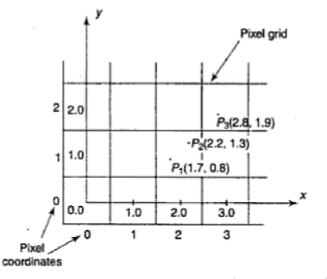
Scan Converting a Point
Align the integer values in the coordinate system for (x , y) with the pixel coordinates.
x΄=Floor (x+0.5) and y΄= Floor (y+0.5)
The origin of the continuous coordinate system for (x , y) is placed at the center of the pixel grid (0,0) in the image space.
Point P₁(1.7,0.8) in represented by pixel (2,1).

Slide 5
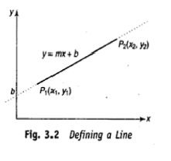
Scan Converting a Line
A line in a computer graphics typically refers to a line segment which is a portion of a straight line that extends indefinitely in the opposite direction.
It is defined by its two end points and the line equation y=mx + b where m is the slope and b is the y intercept of the line.
The line equation describes the coordinated of all points that lie between the two end points.
y
x

Slide 6
Algorithm for Scan Converting a Line
Direct use of the line equation (Self Study)
DDA Algorithm
Bresenham’s Line Algorithm

Slide 7
DDA Algorithm
The Digital Differential Analyzer (DDA) is an incremental scan conversion method.
Such an approach is characterized by performing calculation at each step using results from preceding steps.
m | x_{k+1} | y_{k+1}
m < 1 | x_{k+1}= x_{k} +1 | y_{k+1}= y_{k} +m
m >1 | x_{k+1}= x_{k} +(1/m) | y_{k+1}= y_{k} +1
m = 1 | x_{k+1}= x_{k} +1 | y_{k+1}= y_{k} +1

Slide 8
DDA Algorithm (Cont..)
Two end points are given: (x₁,y₁) and (x₂,y₂)
Compute dx and dy and compute m.
compare between dx and dy.
If |dx| is greater than |dy|, step size will be |dx|; otherwise step size will be |dy|.
Compute x_{inc} =dx/step and y_{inc} =dy/step.
Plot the pixel (x₁,y₁) and then increment x₁ and y₁ x₁=x₁+x_{inc} and y₁=y₁+y_{inc}.
Continue this process until the iteration reaches to step size.

Slide 9
Problem Solving Using DDA Algorithm
The end points of a line are (5,4) and (12,7). Computer each value of x and y and plot the results.
The end points of a line are (5,7) and (10,5). Computer each value of x and y and plot the results.
The end points of a line are (12,9) and (17,14). Computer each value of x and y and plot the results.
The end points of a line are (17,14) and (12,9). Computer each value of x and y and plot the results.
[For solution pls check the class lecture]

Slide 10
Limitation of DDA
This algorithm is faster than direct use of line equation since it calculates points on the line without any floating point multiplication.
It deals with the rounding off operation and floating point arithmetic so it has high time complexity.
As it is orientation dependent, so it has poor endpoint accuracy.
Due to the limited precision in the floating point representation it produces cumulative error.

Slide 11
Bresenham’s Line Algorithm
Bresenham’s Line Algorithm is a highly efficient incremental method for scan converting lines.
It produces mathematically accurate results using only integer addition, subtraction and multiplication by 2, which can be accomplished by a simple arithmetic shift operation.

Slide 12
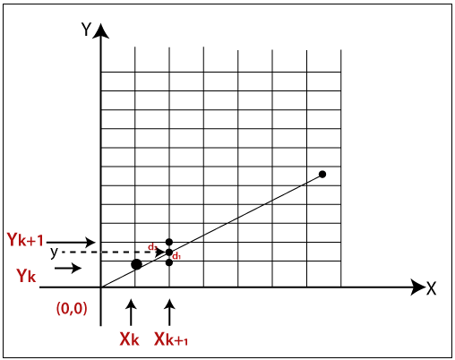
Bresenham’s Line Algorithm
For scan-converting the line shown in the figure here 0<m<1.
Start with the first pixel of the line.
Then select subsequent pixels to the right, one pixel at a time in the horizontal direction towards the end pixel.
Once a pixel is chosen at any step, the pixel is either the one to its right or the one to its right and up.
Choose the pixel who has minimum distance from its true path between the first and last pixel of the line.

Slide 13
Bresenham’s Line Algorithm
We know that m= (dy/dx) and initial decision variable, p= 2dy-dx.
** Pls follow class lecture for details explanation
m | p | x_{k+1} | y_{k+1} | Updated value of p
m<1 | p<0 | x_{k+1}=x_{k} +1 | y_{k+1}=y_{k} | p = p+2dy
 | p≥0 | x_{k+1}=x_{k} +1 | y_{k+1}=y_{k} +1 | p = p+2dy-2dx
m>1 | p<0 | x_{k+1}=x_{k} | y_{k+1}=y_{k} +1 | p = p +2dx
 | p≥0 | x_{k+1}=x_{k} +1 | y_{k+1}=y_{k} +1 | p = p+2dx-2dy

Slide 14
Bresenham’s Line Algorithm for |m|<1
Given two end points: (x₁,y₁) and (x₂,y₂)
Start with first point (x₁,y₁) and plot the first pixel.
Compute dx, dy, m and initial value of decision parameter that is p= 2dy-dx.
At each x_{k}, along the line, starting at k=1, perform the following:
If p_{k} <0 , the next point to plot is (xk+1,yk) and p_{k+1}= p_{k} +2dy.
Otherwise, the next point to plot is (x_{k+1}, y_{k+1}) and p_{k+1}= p_{k} +2dy-2dx.
Repeat this process until the value of x reaches to x₂.

Slide 15
Problem Solving using Bresenham’s Algo
Indicate which raster location would be chosen by Bresenham’s algorithm when a scan converting line from pixel coordinate (1,1) to pixel coordinate (8,5).
[For solution, follow the class lecture]

Slide 16
Scan Converting a Circle
A circle is a symmetrical figure.
Any circle generating algorithm can take advantage of the circle’s symmetry to plot eight points for each value that the algorithm calculates.
Eight way symmetry is used by reflecting each calculated point around each 45 degree axis.
For example, if point 1 in figure was calculated with a circle algorithm, seven more points could be found by reflection.

Slide 17
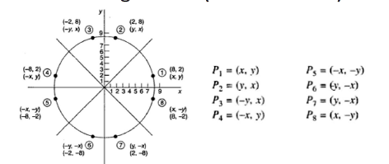
Scan Converting a Circle

Slide 18
Algorithm for Scan Converting a Circle
Generate circle using polynomial method [Self Study]
Generate circle using Trigonometric method [Self Study]
Bresenham’s Circle Algorithm
Mid Point Circle Algorithm

Slide 19
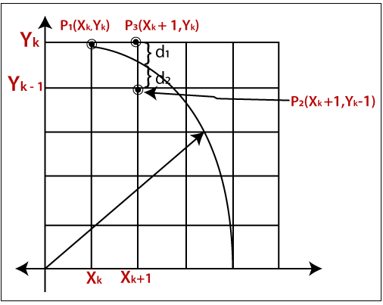
Bresenham’s Circle Algorithm
Highly efficient as it produces mathematically accurate results using only integer addition, subtraction and multiplication by 2, which can be accomplished by a simple arithmetic shift operation.
If the eight-way symmetry of a circle is used to generate a circle, points will be only have to be generated through a 45 degree angle.
If points are generated from 90 degree to 45 degree, moves will be made only in the +x and –y direction.

Slide 20
Bresenham’s Circle Algorithm
Initial decision variable, p=3-2r.
p | x_{k+1} | y_{k+1} | Updated value of p
p≥0 | x_{k+1} = x_{k} + 1 | y_{k+1} = y_{k} -1 | p=p+4(x_{k} - y_{k})+10
p<0 | x_{k+1} = x_{k} + 1 | y_{k+1} = y_{k} | p=p+4x_{k}+6

Slide 21
Bresenham’s Circle Algorithm
Plot initial point (x_{k}, y_{k}) such that x_{k}=0 and y_{k}=r.
Compute the initial decision variable, p_{k}=3-2r.
If p_{k}<0 then
x_{k+1}=x_{k} +1
y_{k+1}=y_{k}
p_{k+1}=p_{k}+4x_{k}+6
If p_{k}≥0 then
x_{k+1}=x_{k} + 1
y_{k+1}=y_{k} - 1
p_{k+1}=p_{k}+4(x_{k}-y_{k})+10
Repeat step 3 and 4 until x≥y.
Plot the points of other seven octant of the circle using eight way symmetry .

Slide 22
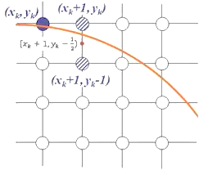
Mid Point Circle Algorithm
Midpoint circle algorithm is another incremental circle algorithm that is very similar to Bresenham’s approach.
It is based on the following functionality for testing the spatial relationship between an arbitrary point (x, y) and a circle of radius r centered at the origin.
f(x, y)= x²+y²-r²
f(x, y)=0 means (x, y) on the circle
f(x,y)<0 means (x,y) inside the circle
f(x,y)>0 means (x,y) outside the circle
M

Slide 23
Mid Point Circle Algorithm
Initial decision variable, p= 1-r or p=(5/4)-r
p | x_{k+1} | y_{k+1} | Updated value of p
p≥0 | x_{k+1} = x_{k} + 1 | y_{k+1} = y_{k} -1 | p=p+2(x_{k} - y_{k})+5
p<0 | x_{k+1} = x_{k} + 1 | y_{k+1} = y_{k} | p=p+2x_{k}+3

Slide 24
Mid Point Circle Algorithm
Plot initial point (x_{k},y_{k}) such that x_{k}=0 and y_{k}=r.
Compute the initial decision variable, p_{k}=(5/4)-r or p=1-r.
If p_{k}<0 then
x_{k+1}=x_{k} +1
y_{k+1}=y_{k}
p_{k+1}=p_{k}+2x_{k}+3
If p_{k}≥0 then
x_{k+1}=x_{k} + 1
y_{k+1}=y_{k} - 1
p_{k+1}=p_{k}+2(x_{k}-y_{k})+5
Repeat step 3 and 4 until x≥y.
Plot the points of other seven octant of the circle using eight way symmetry .

Slide 25
Problem
Plot the first octant of a circle centered at origin, having radius 10 unit using Midpoint Circle algorithm or Bresenham’s Circle Algorithm.
[Pls follow the class lecture for solution]

Slide 26
Region Filling
Region filling is the process of “coloring in” a definite image area or region.
Regions may be defines at the pixel level.
At the pixel level, region is described in 2 ways:
Boundary-defined region
Interior-defined region

Slide 27
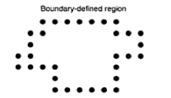
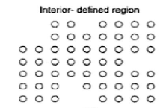
Region Filling
Boundary-Defined Region: Region is described in term of the bounding pixel that outlines it.
Interior-Defined Region: Region is described as the totality of pixels that comprise it.

Slide 28
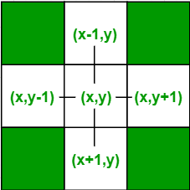
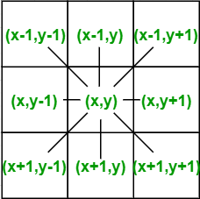
4 connected vs 8 connected

Slide 29
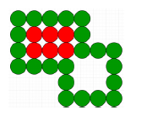
Boundary Fill Algorithm
This is a recursive algorithm that begins with a starting pixel, called a seed, inside a region.
If the color is not equal to the fill color and boundary color, then it filled with fill color and the function is called for all the neighbors of the seed.
If a point is found to be of fill color or of boundary color, the function does not call its neighbors and returns.
This process continues until all points up to the boundary color for the region have been tested.

Slide 30
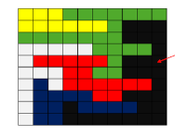
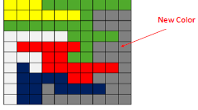
Flood Fill Algorithm
This is a recursive algorithm that begins with a starting pixel, called a seed, inside a region.
If the color is equal to current color, it fills the pixel with new color and the function call its neighbors.
If it is not then the algorithm simply returns to its caller.

Slide 31
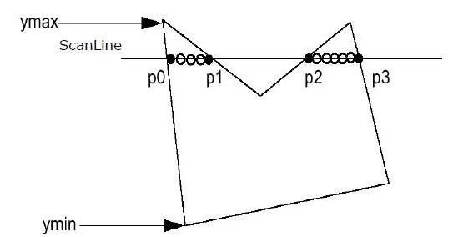
Scan Line Algorithm
Find out the y_{min} and y_{max} from the given polygon.
Scanline intersects with each edge of the polygon from y_{min} to y_{max}. Name each intersection point of the polygon.
Sort the intersection point in the increasing order of X coordinate.
Fill all those pair of coordinates that are inside polygons and ignore alternate pairs.

Slide 32
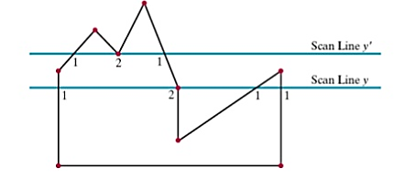
Scan Line Algorithm: Special Cases

Slide 33
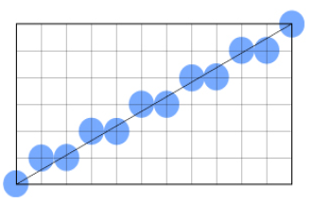
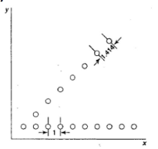
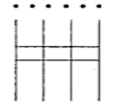
Aliasing Effect
Stair Case:
When scan converting a primitive such as line or circle.
Unequal Brightness:
A slanted line appears dimmer than a horizontal or vertical line, although all are presented at the same intensity level.
Picket Fence
It occurs when an object is not aligned with or does not fit into the pixel grid properly.

Slide 34
Anti Aliasing
It is the technique that can greatly reduces aliasing effects and improve the appearances of images without increasing the resolution.
There are two types of anti aliasing techniques:
Pre-filtering: Filtering before sampling (Area Sampling)
Post-filtering: Sampling before filtering (Super Sampling)
** Self Study: Area Sampling and Super Sampling

Slide 35
Mathematical Problem
** Solve the exercise problems of Chapter 3

Slide 36


